Slide 1
AWS Generative AI

Slide 2
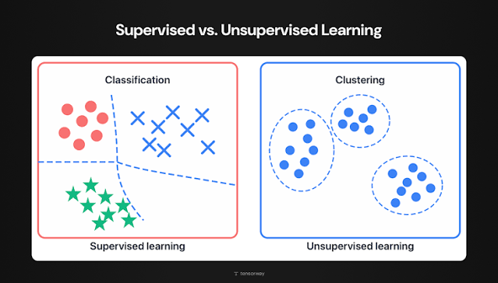
Core AI/ML – Supervised vs. Unsupervised Learning

Slide 3
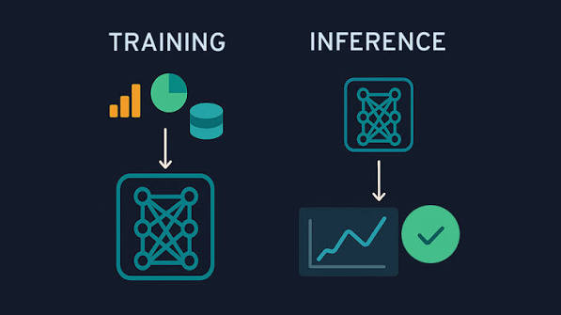
Core AI/ML – Training vs. Inference

Slide 4
THANKS FOR WATCHING

